Slide 1

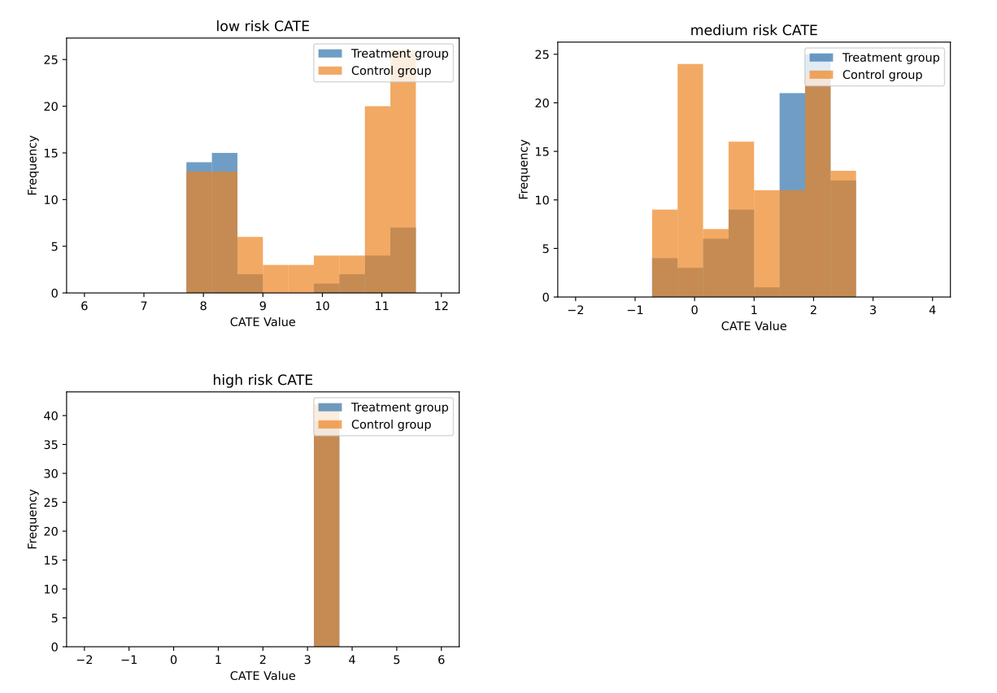
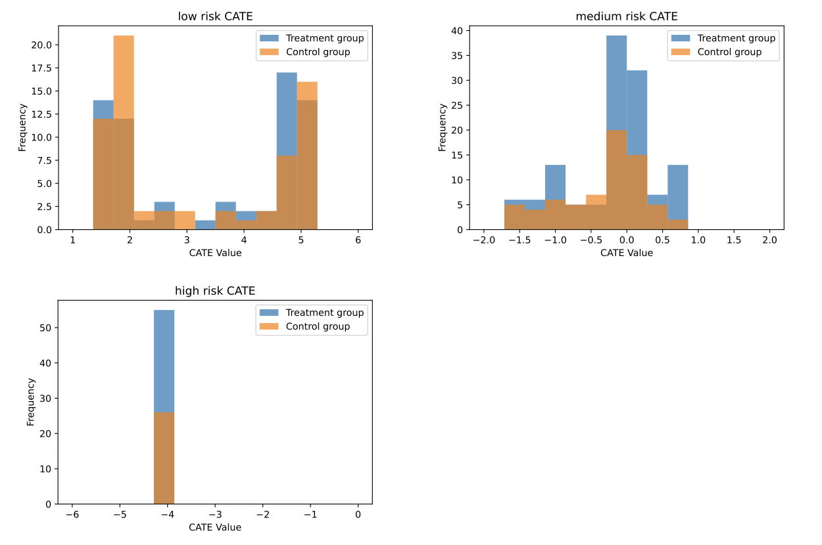
Predictive Modeling of Postpartum Blood Pressure Spikes
Jinxin Tao, MS¹, Scott Infusino, MD², Kara Hoppe, MD², Yonatan Mintz, PhD¹
1, Department of Industrial and Systems Engineering, University of Wisconsin-Madison College of Engineering, Madison, WI, United States of America
2, Department of Obstetrics and Gynecology, University of Wisconsin-Madison School of Medicine and Public Health, Madison, WI, United States of America
Abstract
Methods
Conclusions
Objective: To evaluate clinical predictors of blood pressure (BP) spikes postpartum (PP) and investigate clinical management strategies to optimize care.
Study Design: A retrospective cohort study of PP women participating in remote BP monitoring. Postpartum BP spike was defined as BP > 140/ 90 if on an antihypertensive and BP > 150/100 if not on an antihypertensive. We identified 3 at-risk patient clusters (low, medium, and high) in predicting patient risk of BP spike PP days 3-7. The variables most important in defining these clusters were BMI, tobacco use, gestational age at delivery, and chronic hypertension. For each risk cluster, we evaluated the effectiveness of two discharge policies by estimating the conditional average treatment effect (CATE) with causal forest: 1) PP length of stay < or >/= 3 days, 2) discharge on BP meds based on predicted risk, and for all patients we evaluated: 3) discharge policies on BP meds based on different BP thresholds. A CATE value of <0 represented treatment having a positive effect in treating or preventing spikes and a smaller policy evaluation value showed that treatment has a greater effect in treating or preventing spikes.
Results: 413 patients were included, of which 267 (64.6%) had a PP BP spike. For patients at high risk, a longer stay was beneficial. For patients at low or high risk, antihypertensive use at discharge is not critical in preventing a BP spike. Finally, we considered the option to discharge with antihypertensive use at different BP thresholds a) > 130 mmHg and/or > 80, b) > 140 mmHg and/or > 90, c) > 150 mmHg and/or > 100 or d) > 160 mmHg and/or > 110. The second policy is significantly better.
Conclusion: We identified 3 possible strategies to prevent outpatient BP spikes PP: 1) medium and high-risk patients should be considered for a longer PP stay or participate in daily home monitoring, 2) medium-risk patients should be prescribed antihypertensives at discharge, and 3) antihypertensive treatment should be prescribed if patients are discharged with BP > 140/90.
We performed a retrospective cohort study at a single Midwestern academic center from 2017 to 2020, including patients with a diagnosis of hypertension during pregnancy or postpartum, who participated in remote blood pressure monitoring for 6 weeks postpartum.
Systolic and diastolic BPs were collected from 46 times points including the first (T1), second (T2), and third (T3) trimesters, day of delivery, and 42 postpartum days.
Postpartum BP spike was defined as BP ≥ 140/90mmHg if on an antihypertensive and BP ≥ 150/100mmHg if not on an antihypertensive.
We identified three at-risk patient clusters (low, medium, and high) utilizing K-means clustering over patients’ SBP series data with the elbow method.
Propensity scores were estimated by a non-parametric method with a random forest model.
Using machine learning, we were able to successfully create a model that stratified patients’ risk of blood pressure spikes based on clinical and biometric parameters.
Recommended Clinical Policy Changes:
Patients at medium and high of of postpartum BP spike should be considered for a longer postpartum stay or participate in daily home monitoring. Medium risk patients should also be prescribed antihypertensive medication at discharge.
Antihypertensive medication should be prescribed to patients discharged with a blood pressure of BP ≥ 140/90mmHg.
Utilizing machine learning, healthcare providers can predict postpartum blood pressure spikes and minimize hospital readmission and maternal morbidity.
Results
Table 1: Patient demographics.
Characteristic | All subjects, N=413 | Postpartum BP Spike, N=267 | No Blood Pressure Spike, N=146 | p-value
Maternal Age, yrs (SD) | 31.40 (5.03) | 31.88 (4.69) | 30.53 (5.46) | 0.009
Parity, n (%) |  |  |  | 0.59
Nulliparous | 153 (37) | 99 (37) | 54 (37) | -
Multiparous | 87 (21) | 63 (24) | 24 (16) | -
Unknown | 173 (42) | 105 (39) | 68 (47) | -
Gestational Age at Delivery, weeks (SD) | 37.94 (2.43) | 37.95 (2.19) | 37.93 (2.81) | 0.94
Pre-pregnancy BMI, kg/m², mean (SD) | 29.70 (7.7) | 30.53 (8.0) | 28.17 (6.9) | 0.003
Race, n (%) |  |  |  | 0.95
Black | 12 (2.9) | 8 (3) | 4 (2.7) | -
White | 369 (89.4) | 241 (90.3) | 128 (87.7) | -
Other | 32 (7.6) | 18 (6.7) | 14 (9.6) | -
Hispanic, n (%) | 17 (4.1) | 15 (5.6) | 2 (1.4) | 0.23
Insurance, n (%) |  |  |  | 0.49
Public | 31 (7.5) | 16 (6) | 15 (10.3) | -
Private | 382 (92.5) | 251 (94) | 131 (89.7) | -
Mode of Delivery, n (%) |  |  |  | 0.434
Vaginal | 227 (55) | 139 (52) | 88 (60) | -
Cesarean | 186 (45) | 128 (48) | 58 (40) | -
Hypertension diagnosis, n (%) |  |  |  | 0.783
Gestational Hypertension | 190 (46) | 116 (43.4) | 74 (50.7) | -
Chronic Hypertension | 75 (18.2) | 57 (21.3) | 18 (12.3) | -
Preeclampsia | 149 (36.1) | 101 (37.8) | 48 (32.9) | -
Preeclampsia w/ Severe Features | 98 (23.7) | 63 (23.6) | 35 (24) | -
Superimposed Preeclampsia | 26 (6.3) | 19 (7.1) | 7 (4.8) | -
HELLP | 2 (0.5) | 2 (0.75) | 0 (0) | -
Eclampsia | 3 (0.7) | 1 (0.37) | 2 (1.4) | -
Clinical Feature | Importance
Peak Systolic BP prior to discharge | 0.233
Trimester Specific Systolic Blood Pressure | 0.178
BMI | 0.184
Heart Rate | 0.125
Gestational Age at Delivery | 0.123
Maternal Age | 0.096
Chronic Hypertension | 0.039
Gestational Hypertension | 0.022
Policy (give meds at discharge bp if) | >130/80 | >140/90 | >150/100 | >160/110
Policy evaluation score 95% CI | 143.93 +/- 0.019 | 143.35 +/- 0.016 | 143.89 +/- 0.018 | 143.91 +/- 0.018
Table 3: Policy evaluation value for options on discharging with antihypertensive use at different BP thresholds at discharge
Background
Hypertensive disorders of pregnancy is one of the leading causes of maternal morbidity and mortality worldwide.
Pregnancies complicated by hypertensive disorders often have a persistence or exacerbation of hypertension in the postpartum period.
While different strategies have been proposed to manage postpartum blood pressure strikes, there is not a model of clinical care proven to be more advantageous.
Few studies have used machine learning as a tool to predict postpartum blood pressure spikes and readmission.
Table 2: Feature importance for risk prediction
Data are given as mean +/- SD or n (%)
Comparative test: t-test, chi-square as appropriate
Figure 1: Number of patients in treatment group (discharged with medication) and control group within clusters based on CATE value
Figure 2: Number of patients in treatment group (observed inpatient >3 days postpartum) and control group within clusters based on CATE value
Objective
References
The objective of this study was to evaluate clinical predictors of postpartum blood pressure spikes and investigate clinical management strategies using machine learning to optimize care.
Narmin Mukhtarova, Scott J. Hetzel, Heather M. Johnson & Kara K. Hoppe (2021): Longitudinal blood pressure patterns of women with hypertensive disorders of pregnancy: preconception through postpartum, The Journal of Maternal-Fetal & Neonatal Medicine, DOI: 10.1080/14767058.2021.2012650
Hirshberg A, Levine LD, Srinivas SK. Clinical factors associated with readmission for postpartum hypertension in women with pregnancy-related hypertension: a nested case control study. J Perinatol. 2016 May;36(5):405-9. doi: 10.1038/jp.2015.209. Epub 2016 Jan 14. PMID: 26765549; PMCID: PMC5480459.
Mukhtarova N, Alagoz O, Chen YH, Hoppe K. Evaluation of different blood pressure assessment strategies and cutoff values to predict postpartum hypertension-related readmissions: a retrospective cohort study. Am J Obstet Gynecol MFM. 2021 Jan;3(1):100252. doi: 10.1016/j.ajogmf.2020.100252. Epub 2020 Oct 6. PMID: 33451628.
Hoffman MK, Ma N, Roberts A. A machine learning algorithm for predicting maternal readmission for hypertensive disorders of pregnancy. Am J Obstet Gynecol MFM. 2021 Jan;3(1):100250. doi: 10.1016/j.ajogmf.2020.100250. Epub 2020 Oct 6. PMID: 33451620.
Hoppe KK, Thomas N, Zernick M, Zella JB, Havighurst T, Kim K, Williams M, Niu B, Lohr A, Johnson HM. Telehealth with remote blood pressure monitoring compared with standard care for postpartum hypertension. Am J Obstet Gynecol. 2020 Oct;223(4):585-588. doi: 10.1016/j.ajog.2020.05.027. Epub 2020 May 19. PMID: 32439388.

